Slide 1

Library Management System Using Java

Slide 2
Existing System Overview
Manual Processes
Limited Accessibility
Inefficient Management
Managing library resources, such as books, journals, and multimedia, can be cumbersome without a centralized system.
Traditional library systems often rely on manual record-keeping, leading to inaccuracies and inefficiencies.
Users may face challenges accessing library resources due to limited online presence and search capabilities.

Slide 3
Proposed System Overview
Automated Processes
Enhanced Accessibility
The proposed system automates tasks such as book borrowing, returning, and overdue reminders.
Users can access library resources online, search for books, and manage their accounts conveniently.
Centralized Management
The system provides a central database for managing library resources and user information.

Slide 4
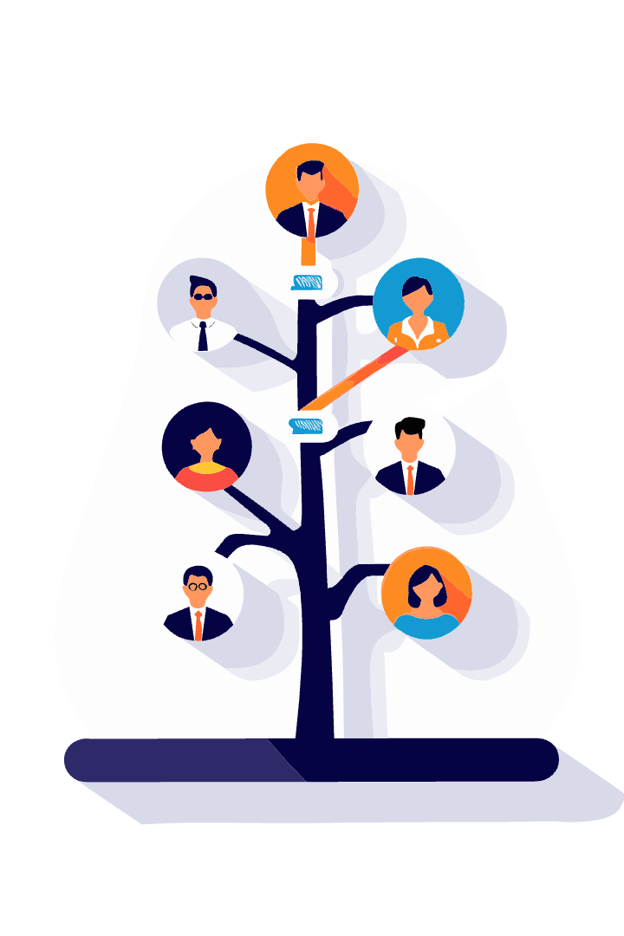




Flowchart
User Login
Users authenticate themselves with their credentials.
Search for Resources
Users can browse the library catalog and search for
Specific books.
Borrow/Return Books
The system manages book borrowing and returning
Processes.
Overdue Notifications
The system sends reminders to users for overdue
Books.

Slide 5
Pseudo Code
// Function to search for a book by its title searchBook(title): // Iterate through the book list for each book in bookList: // Check if the book title matches the input if book.title == title: // Return the book object return book // If the book is not found, return null return null // Function to borrow a book borrowBook(book, user): // Check if the book is available if book.available: // Update the book's availability status book.available = false // Associate the book with the user book.borrower = user // Log the borrowing action logBorrowing(book, user) // Display a success message print("Book borrowed successfully") else: // Display an error message print("Book is not available")

Slide 6

Limitations
Limited Integration
The system may not seamlessly integrate with other library systems.
Security Concerns
Data security and privacy must be addressed to protect sensitive user information.
Maintenance Requirements
Regular updates and maintenance are essential to ensure system stability and functionality.

Slide 7
Key Features and Benefits
1
User-Friendly Interface
2
Automated Overdue Management
The system provides an intuitive and easy-to-use interface for both librarians and users.
The system automatically sends reminders to users for overdue books, reducing manual intervention.
3
Improved Book Availability
4
Enhanced Reporting
The system generates comprehensive reports for analyzing library usage and resource management.
The system tracks book availability in real-time, ensuring that users can easily find the books they need.

Slide 8

Conclusion and Future Scope
1
Implementation
The proposed library management system using Java has the potential to revolutionize library operations.
2
Future Enhancements
Future developments could include integration with online databases, mobile app development, and advanced search capabilities.
User Feedback
3
Collecting user feedback will be crucial for refining the system and ensuring it meets user needs effectively.

Slide 9
THANK YOU

